Slide 1
Zivra DevOps CI/CD and EM Course -
Chef Concepts and Basics

Slide 2
Setup
1. Access your folder within the Workstation:
- Open your favorite terminal
- Access :
IP: ec2-34-210-231-32.us-west-2.compute.amazonaws.com Username: centos
- Use the USC SSH key in https://github.com/eespinoza13/DevOpsTraining
2. cd to the Directory: /home/centos/Group-X/chef-repo/cookbooks/
  Each team will have a folder with their group number.

Slide 3
IPs
            (Public/Private)
Group 1 35.163.61.20/ 172.31.13.244
Group 2 34.209.19.234/172.31.5.193
Group 3 34.210.202.181/172.31.8.30
Group 4 54.69.254.216/172.31.4.63
Chef-Server: 52.40.185.60
Chef Workstation: 34.210.231.32

Slide 4
Chef Lab 1
Exercise 1:
Create a Chef recipe that ensures the Apache service is running.
Notes:
Refer to the course Lab Guide manual to complete the Lab 4.1 exercises.
IDEA: Make this easier by giving a set of commands to chose from and then they piece it together.
Upload this cookbook to the Chef-Server with knife, inside the chef-repo directory: $ knife cookbook upload Group-X-httpd
Verify that your cookbook was successfully uploaded to the server with: $ knife cookbook list
Check the name of your node with: $ knife node list

Slide 5
Chef Lab 1 Steps and Hints
Exercise 1:
  Create your recipe within the default.rb file which is already created in ~/Group-X/chef-repo/cookbooks/ Group-x-httpd/recipes, using text editor Nano.
  Hints to writing the Recipe!
  - Apache package name is httpd
  - Make sure the service is ON and running
  (think – what action is this?)
Notes:
inside the chef-repo directory:
$ knife cookbook upload Group-X-httpd
package 'httpd‘
service ‘httpd’ do
action [:enable, :start]
end

Slide 6
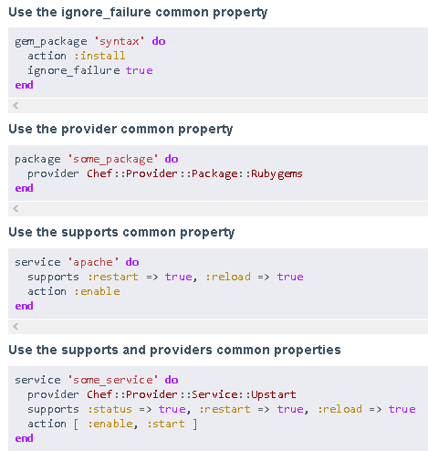
Recipe and Resource Examples
https://docs.chef.io/recipes.html
https://github.com/engineyard/ey-cloud-recipes/tree/master/cookbooks/timezone
https://docs.chef.io/resource_common.html

Slide 7
Chef Lab 1.1 Answer
package 'httpd‘
service ‘httpd’ do
action [:enable, :start]
end

Slide 8
Chef Lab 1
Exercise 2: Upload your Cookbook to the Chef Server using Knife.
Upload this cookbook to the Chef-Server with knife, inside the chef-repo directory: $ knife cookbook upload Group-X-httpd
Verify that your cookbook was successfully uploaded to the server with:
$ knife cookbook list
Check the name of your node with: $ knife node list
Notes:
Refer to the course Lab Guide manual to complete the Lab 4.1 exercises.
IDEA: Make this easier by giving a set of commands to chose from and then they piece it together.
Upload this cookbook to the Chef-Server with knife, inside the chef-repo directory: $ knife cookbook upload Group-X-httpd
Verify that your cookbook was successfully uploaded to the server with: $ knife cookbook list
Check the name of your node with: $ knife node list

Slide 9
Chef Lab 1 Steps and Hints
Exercise 1:
  Create your recipe within the default.rb file (already created in ~/Group-X/chef-repo/cookbooks/ Group-x-httpd/recipes) using text editor Nano.
Exercise 2:
- Upload this cookbook to the Chef-Server with knife, inside the chef-repo directory:
$ knife cookbook upload Group-X-httpd
  Use this command to verify your Cookbook was successfully uploaded:
      $ knife cookbook list
Notes:
inside the chef-repo directory:
$ knife cookbook upload Group-X-httpd

Slide 10
Chef Lab 1 (cont)
Objectives
Exercise 3: Apply this cookbook to your team’s respective node.
Exercise 4: Check that Apache is installed and running in your team’s node.
Notes:
Refer to the course Lab Guide manual to complete the Lab 4.1 exercises.

Slide 11
Chef Lab 1 Steps and Hints
Exercise 3:
- You will need to reference the following in this command:
- Name of your node (can be found with Knife – do you need a hint?)
- User: centos
- The name of the pem file received
Try this command in a different file: /Group-X/chef-repo
knife ssh 'name:group-X-node' 'sudo chef-client' --ssh-user centos --identity-file ~/.ssh/USC.pem
Exercise 4:
$ knife node list
$ curl ip-private
  You can check your Node via public IP in your browser as well.
Notes:
$ knife ssh 'name:group-x-node' 'sudo chef-client' --ssh-user USER -- centos identity-file ~/.ssh/USC.pem
/Group-X/chef-repo

Slide 12
Chef Lab 2
Objectives
Disconnect your nodes to the Chef-Server and check that the Apache is still installed and running in their nodes.
Notes:
Refer to the course Lab Guide manual to complete the Lab 4.1 exercises.

Slide 13
Chef Lab 2
Step 1: Disconnect the respective node to the Chef-Server with knife command:
$ knife node delete group-x-node
Step 2: Check that your node is disconnected to the Chef-Server with:
$ knife node list
Step 3: Check that Apache is still running in your node in a browser with the public-ip or $ curl ip-private
Step 4: Try reconnecting the node:
sudo knife bootstrap 172.31.13.244 --ssh-user centos --sudo --identity-file ~/.ssh/USC.pem --node-name group-x-node --run-list 'recipe[Group-x-httpd]'
Notes:
Disconnect the respective node to the Chef-Server with knife command:
$ knife node delete group-x-node
Check that your node is disconnected to the Chef-Server with:
$ knife node list
Check that Apache is still running in your node in a browser with the public-ip

